Slide 1
Social Listening Solution
TEAM 1

Slide 2
Agenda
Project Overview & Business Context
Live Demo: SSO, QuickSight
High-Level Architecture & WAR
Modernization (ECS Fargate, CI/CD Pipeline)
Q&A

Slide 3
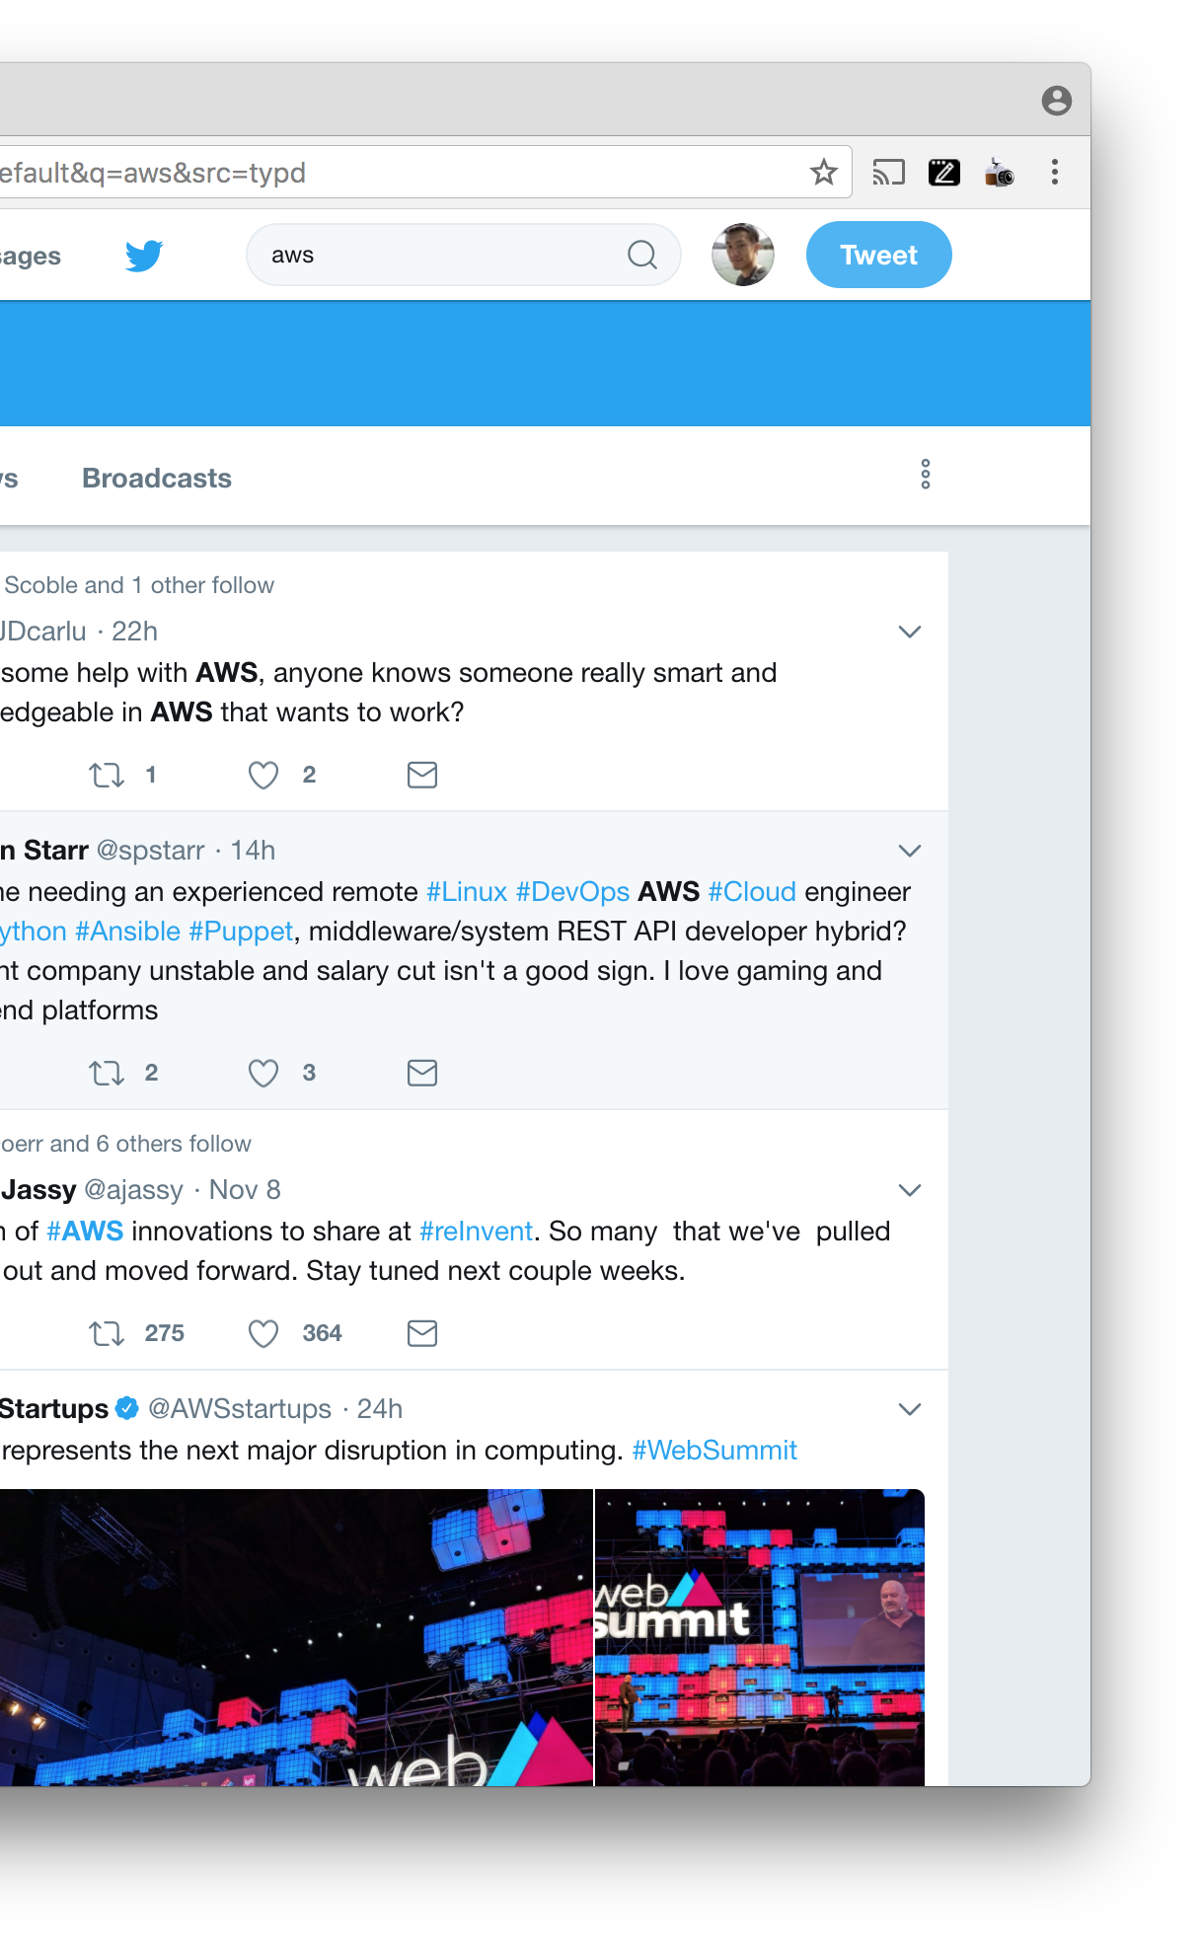
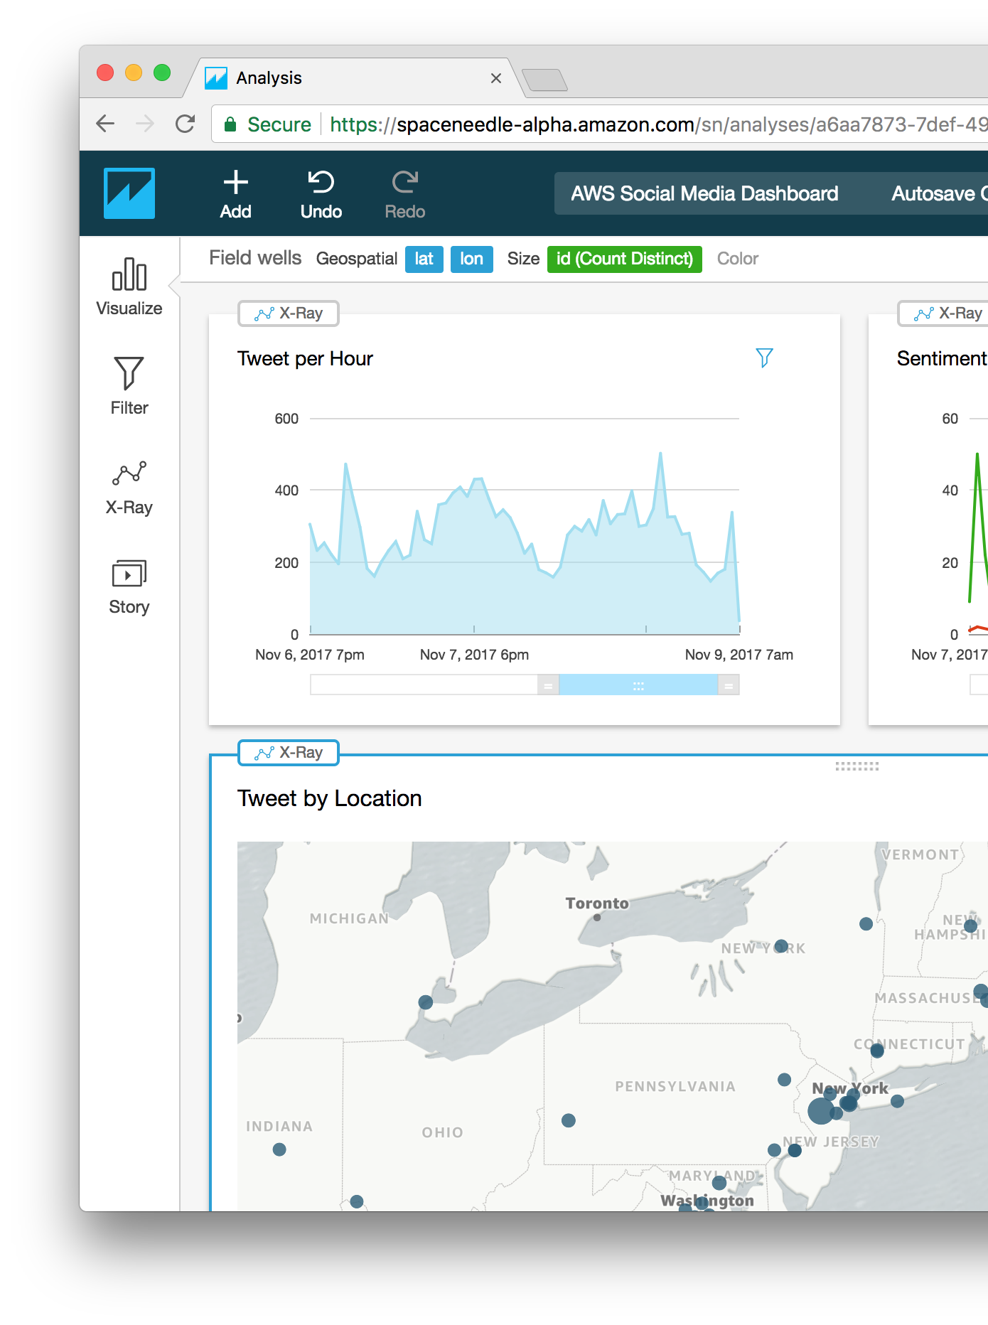
Social Media & brand awareness
﻿Companies can gain valuable insight and deepen brand awareness by analyzing their social media interactions with customers
AI-Driven Social Media Dashboard
‘aladin’
Analyze positive and negative mentions about your business. Protect your reputation with social media monitoring, detect potential sales, reach customers, and protect your reputation

Slide 4
We- Unicorn Retailer want to design a solution to
Monitor social media channels for mentions of our brand, competitors, products, and keywords related to our business.
Analyze the information for ways to put what we learn into action.
Social media key metrics:
Brand mentions
Relevant hashtags
Competitor mentions
Industry trend
Custom metrics to be defined

Slide 5
We- Unicorn Retailer want to design a solution to (cont.)
Why social listening matters? It changes the way how we :
Engage with customers
Manage crisis
Track competitors
Find pain points
Discover new sales leads
Identify influencers and advocates
CTO requirement?
We have built our first MVP in house base on AWS architecture
We need AWS to help us through the journey of modernizing the application
Must meet these design criteria
Fast roll out of the first Ai-Driven sentiment processing
The architecture can be involved
The architecture is open for integration security

Slide 6
demo

Slide 7

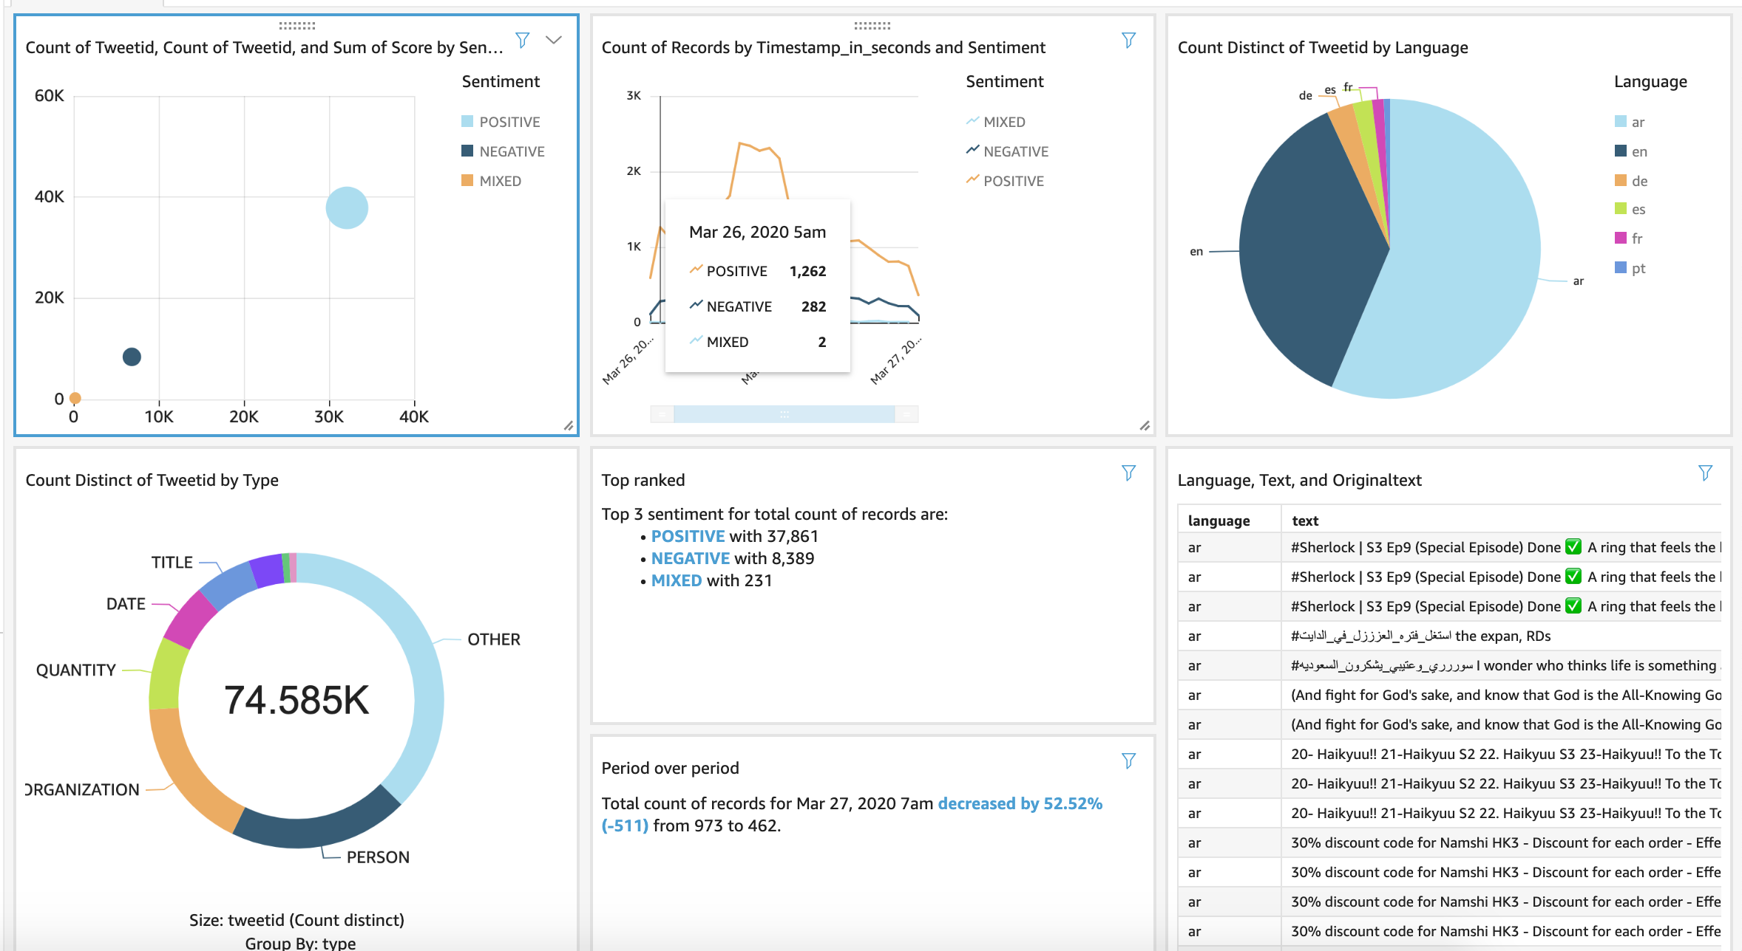
Demo
Quick Sight - Desktop
Quick Sight - Mobile

Slide 8
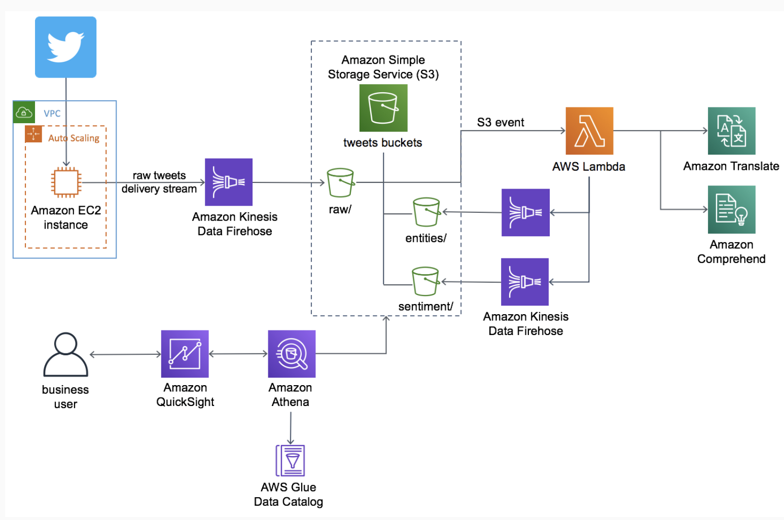
Current architecture
Architecture
Notes:
﻿Using machine learning (ML) and business intelligence (BI) services from Amazon Web Services (AWS), including Amazon Translate, Amazon
Comprehend, Amazon Kinesis, Amazon Athena, and Amazon QuickSight, businesses can build meaningful, low-cost social media dashboards to analyze customer sentiment, which can lead to better opportunities for acquiring leads, improve website traffic, strengthen customer relationships, and improve customer service.
To help customers more easily build a natural-language-processing (NLP)-powered social media dashboard for customer feedback, AWS offers the AI-Driven Social Media Dashboard.
This solution automatically provisions and configures the AWS services necessary to capture multi-language tweets in near real-time, translate them, and display them on a dashboard powered by Amazon QuickSight.
You can also capture both the raw and enriched datasets and durably store them in the solution's data lake. This allows data analysts to quickly and easily perform new types of analytics and ML on this data

Slide 9
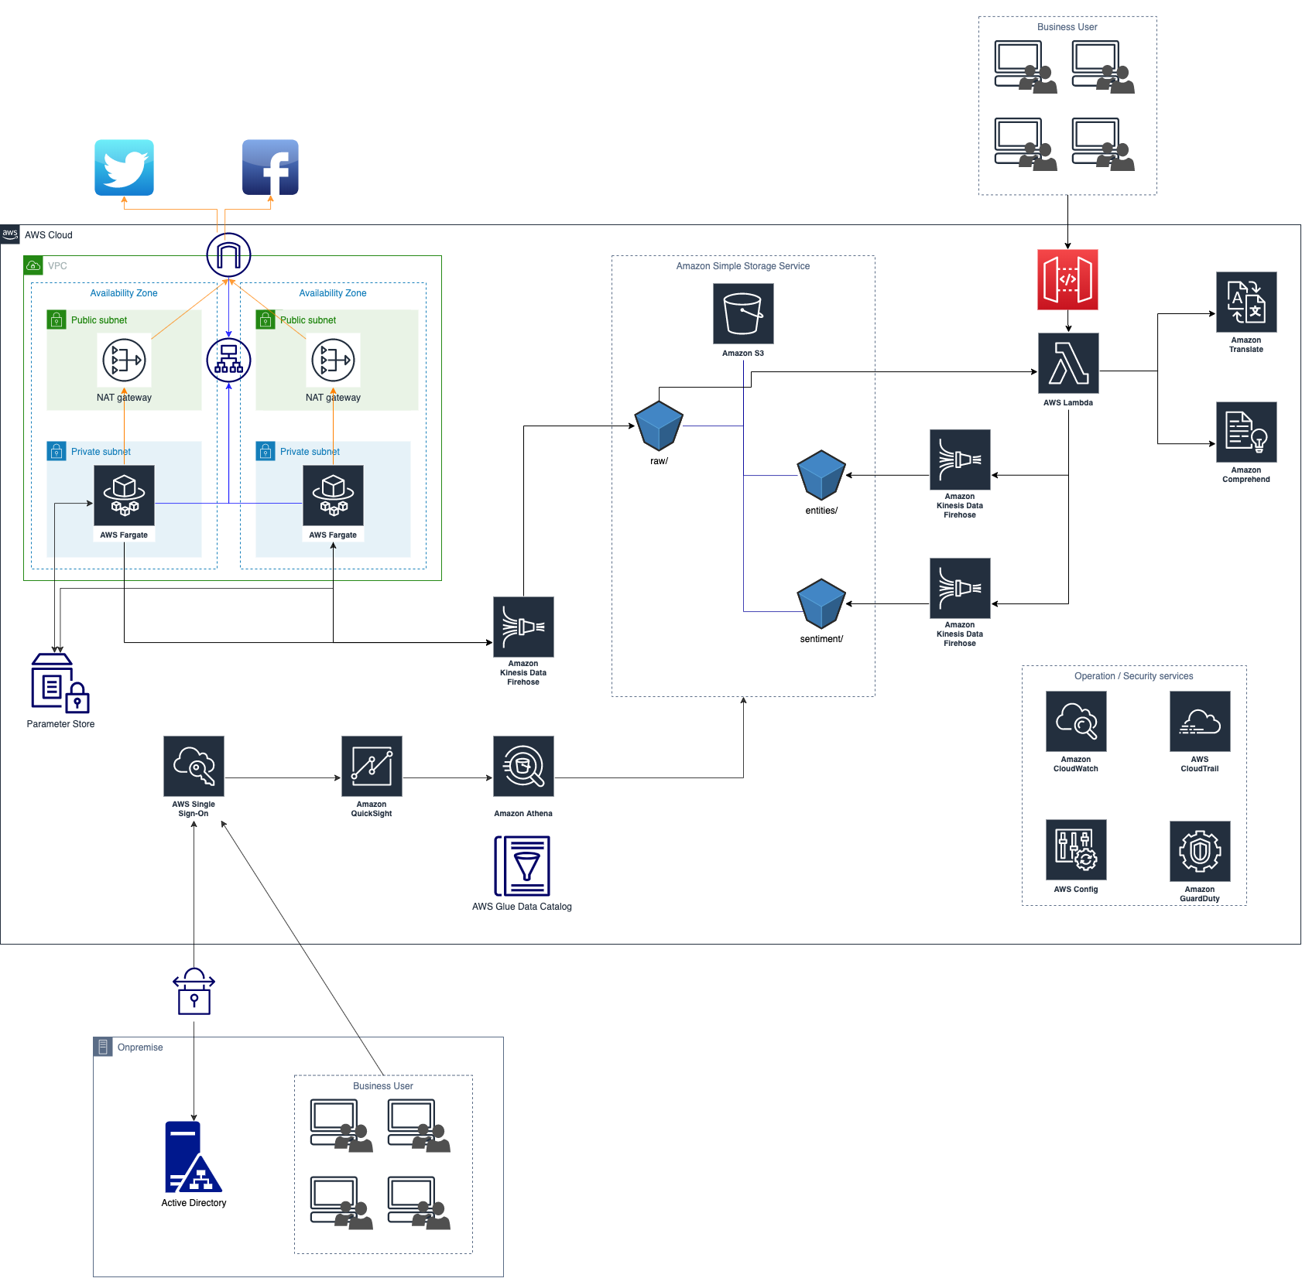
New Architecture
Notes:
﻿Using machine learning (ML) and business intelligence (BI) services from Amazon Web Services (AWS), including Amazon Translate, Amazon
Comprehend, Amazon Kinesis, Amazon Athena, and Amazon QuickSight, businesses can build meaningful, low-cost social media dashboards to analyze customer sentiment, which can lead to better opportunities for acquiring leads, improve website traffic, strengthen customer relationships, and improve customer service.
To help customers more easily build a natural-language-processing (NLP)-powered social media dashboard for customer feedback, AWS offers the AI-Driven Social Media Dashboard.
This solution automatically provisions and configures the AWS services necessary to capture multi-language tweets in near real-time, translate them, and display them on a dashboard powered by Amazon QuickSight.
You can also capture both the raw and enriched datasets and durably store them in the solution's data lake. This allows data analysts to quickly and easily perform new types of analytics and ML on this data

Slide 10
Improvements from well-Architected
Security:
AWS Config with 08 rules: IAM password policy, S3 public-read-prohibited, encryption, sg-open,..
Enable CloudTrail
Enable GuardDuty
Move ECS to private subnets
Deploy SSO for business users
Reliability:
Deploy ECS in 02 private subnets with 02 NAT gateway in 02 public subnets
Scaling at task level with ECS
Manage change in automation with CI/CI pipeline
Performance:
Using advanced technologies with ECS
Use serverless architectures
Cost optimization:
Matching supply and demand by using serverless architecture
Need to optimize the cost of Translate and Comprehend. Currently the cost of Translate and Comprehend is 80% of total cost

Slide 11
Resources
https://github.com/nnthanh101/social-listening
Architecture
ECS Fargate
CloudFormation
https://datalake.aws.job4u.io/en/introduction/modules/
https://ecs-fargate.aws.job4u.io/vi/intermediate/platform/
https://github.com/nnthanh101/social-listening/projects/1
https://aws.amazon.com/solutions/ai-driven-social-media-dashboard/

Slide 12
Thank YOU!

